Slide 4
Using the Hiland PPT Template
Open the template.
To add a new slide:
Click the arrow beside the New Slide button in the Home toolbar. This will display a dropdown selection of formatted slides for you to choose from.
Click on the slide format you wish to add to your presentation.
NOTE: If you just click New Slide and do not choose from the pre-formatted slide selections, your slide will not be formatted correctly. For example, the font, text color and text size will be wrong. The bullets will not be blue. Elements of the slide will not be spaced properly.
If you have questions, please contact Kelly Bentley.

Slide 5
THE IMPORTANCE OF HILAND’S MILK
Most of our products start with Hiland Dairy’s pure and fresh milk:
Tested and guaranteed free of: o Artificial growth hormones o Antibiotics
We produce the best quality milk possible for our families and our customers
Hiland is farmer-owned, and our milk is locally sourced and produced

Slide 6
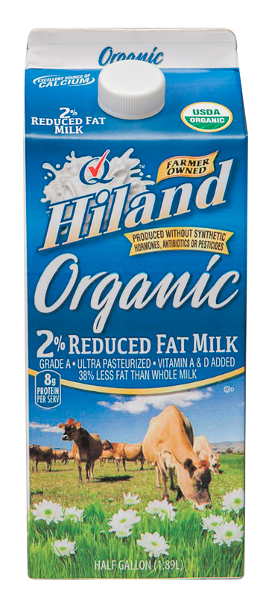
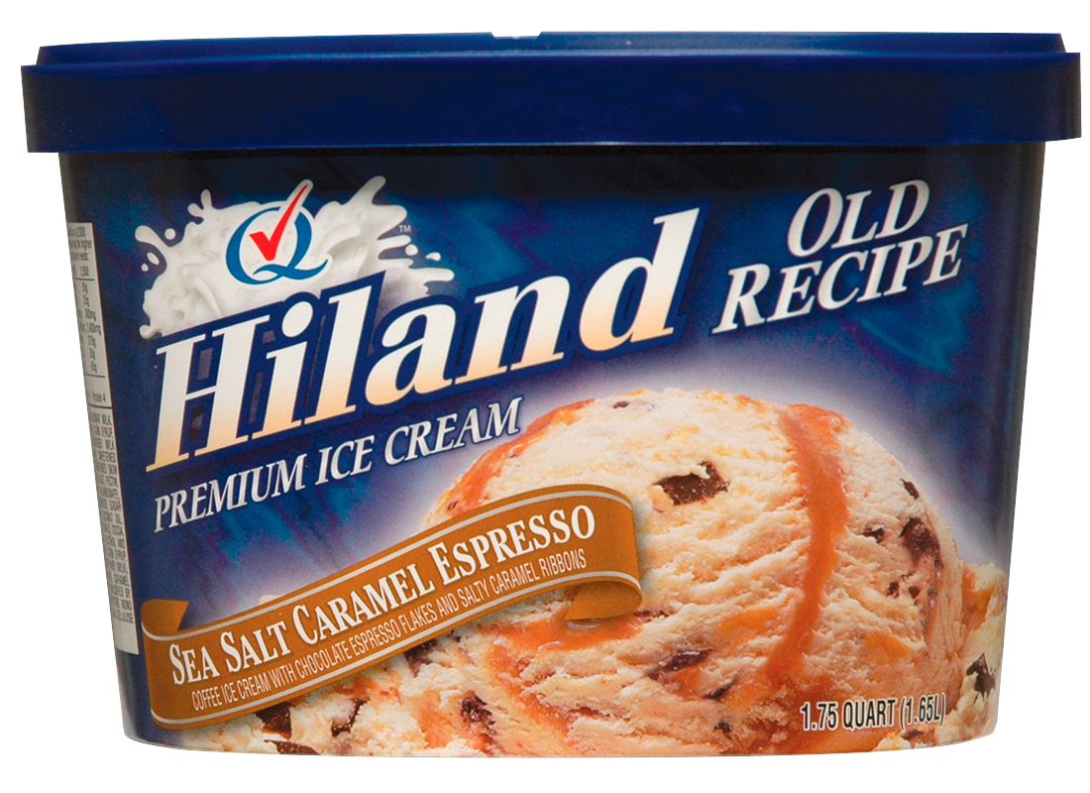
BREAKING NEW GROUND
We are committed to providing our customers with innovative products:
Flavored milk
Lactose-free and organic milk
Original ice cream flavors
Delicious dips
Yogurt
Fruit juices and flavored drinks

Slide 7
COMMITTED TO THE DAIRY INDUSTRY
We show this commitment through our involvement in industry organizations:
IDFA
DMI
MilkPEP
Dairy Farmers of America
Quality Chekd

Slide 8
HOW FAR WE’VE COME
1945: Hiland Dairy grew to include a distribution center with 25 employees and 11 dairy routes
1955: Became a member of Quality Chekd
Today: 12 plants, 7 states, 49 distribution centers

Slide 9
HILAND
SCHOOL MILK PROGRAM

Slide 10
HilandDairy.com

Slide 11
