Slide 1
Introducing Hiland Dairy’s Fresh Lactose-Free Milk
NAME
TITLE

Slide 5
Alt Beverages Continue to Decline
Fluid milk continues to outpace alternative beverage sales by nearly nine to one
Overall, alt beverages were down 6.6% (2023YTD)
Segments that have shown strength historically continue to perform well. Whole milk posted a 0.5% volume increase year-to-date with accelerated growth in the latest 4-weeks (+1.4%).
Lactose free milk also remains a bright spot with volume up 7% in 2023YTD versus year ago with the same growth in the latest period.
Both white and flavored lactose-free milks are experiencing gains in 2023.
Flavored lactose-free has recovered from its downturn in 2022/early 2023 and is now running above previous years’ volume levels.
Source: DMI Fluid Milk Retail Report through 12/3/23

Slide 6
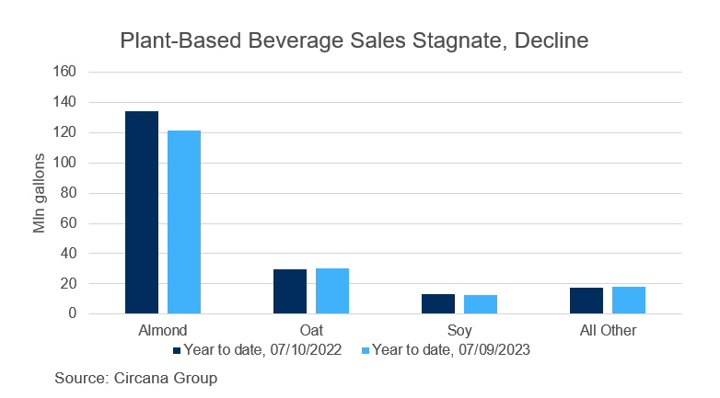
Lactose free shoppers are trained to go to the alternative beverage section for a purchase. Removing low-sale products makes room for lactose free gallons and increased sales.

Slide 8
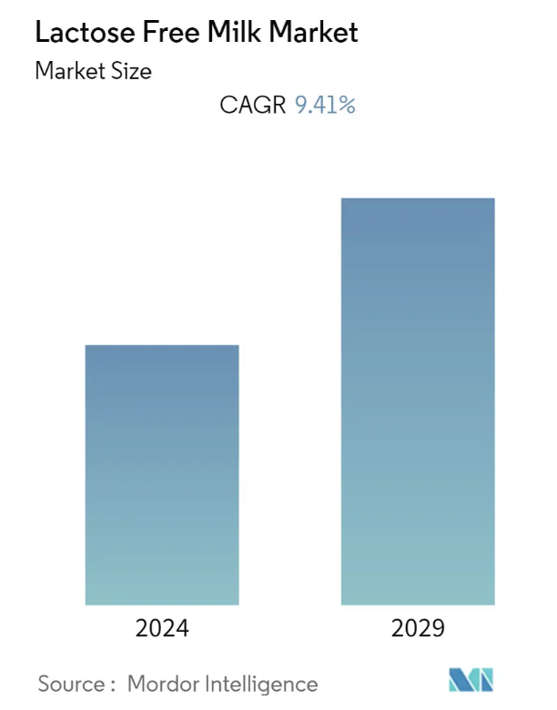
The Growing Market for Lactose Free Milk
The lactose free milk market is projected to register a compound annual growth rate of 9.41% during the forecast period, 2022-2027.

Slide 9
The Growing Market for Lactose Free Milk
Offering lactose free products enables a wide range of customers to consume the products while continuing to benefit from the nutritional aspects of dairy. Other benefits of lactose free that are particularly on trend with consumers right now are:
Digestive health
Sugar claims
A desire for lower/no-sugar products and following a plant-based eating/lifestyle
Source: https://www.dairyfoods.com/articles/96322-lactose-free-dairy-global-market-nears-7b

Slide 10
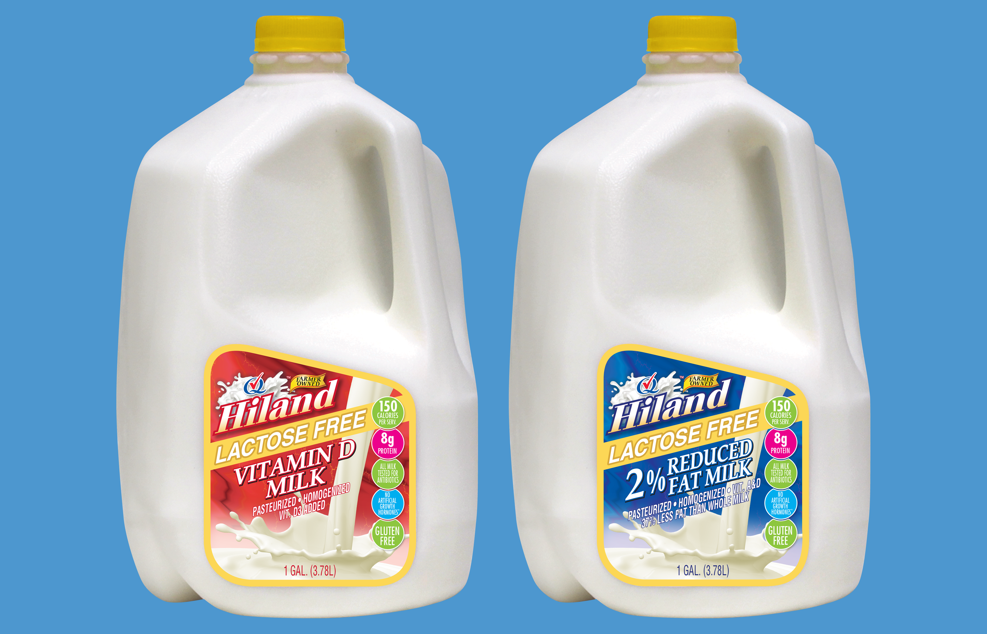
Hiland Dairy Lactose Free Milk
Available in whole and 2% gallons
Why Hiland Lactose Free Milk:
Freshness and taste superiority over UHT milk
Nutritional benefits
Local Kansas City production - appeal to local consumers

Slide 11
Consumer Benefits
Same nutrients as conventional milk without the lactose
Gallon size is perfect for the whole family
Premium quality product with a lower per ounce cost vs UHT

Slide 12
Retailer Benefits
Meeting growing consumer demand
Enhancing the store’s reputation for carrying high-quality local products and serving all cultures
Competitive pricing and margin

Slide 13
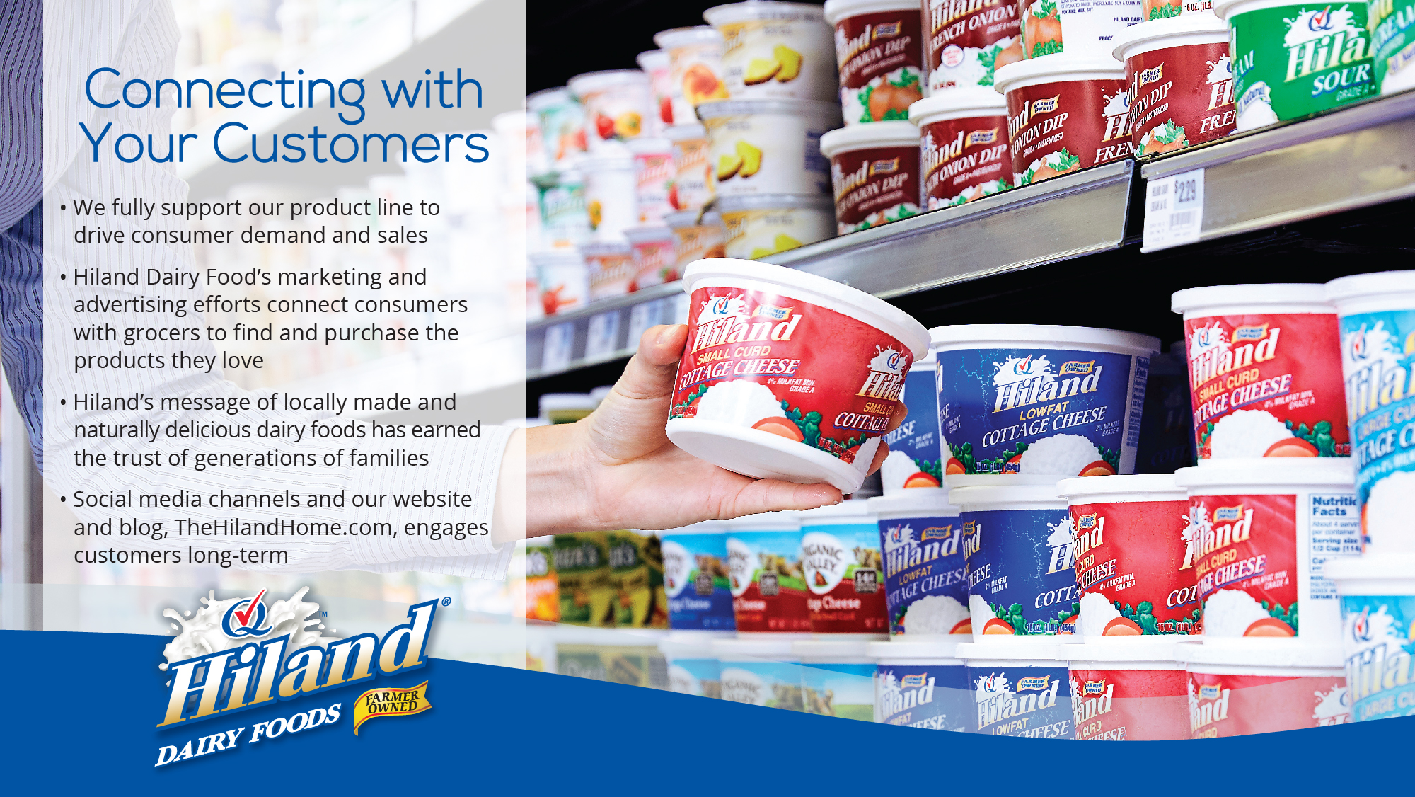

Slide 16
Ordering and Delivery Details
UPDATE BELOW INFORMATION
Information on order sizes, delivery schedules, and shelf life
Contact details for order

